Slide 1
Event Logging
CS 4981 ML Production Systems
RJ Nowling

Slide 2

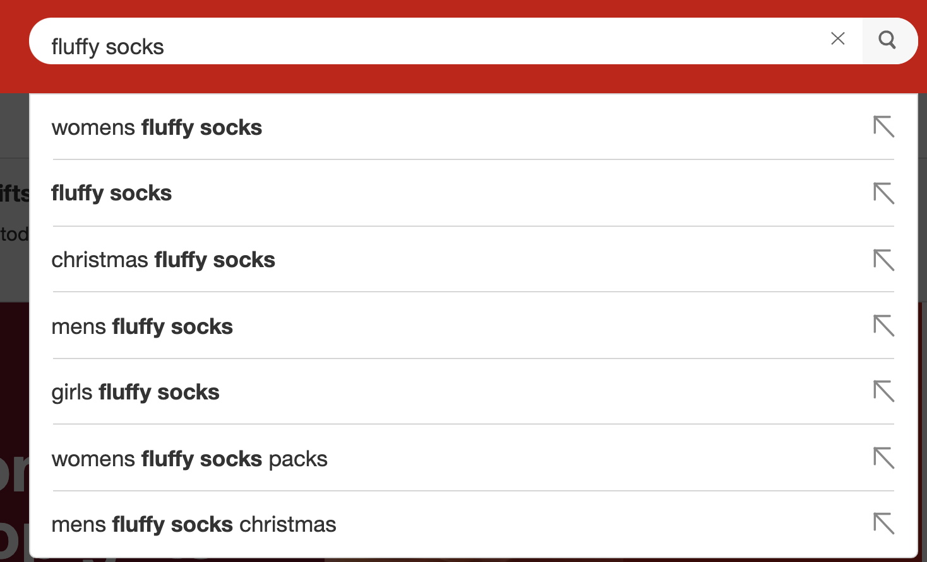

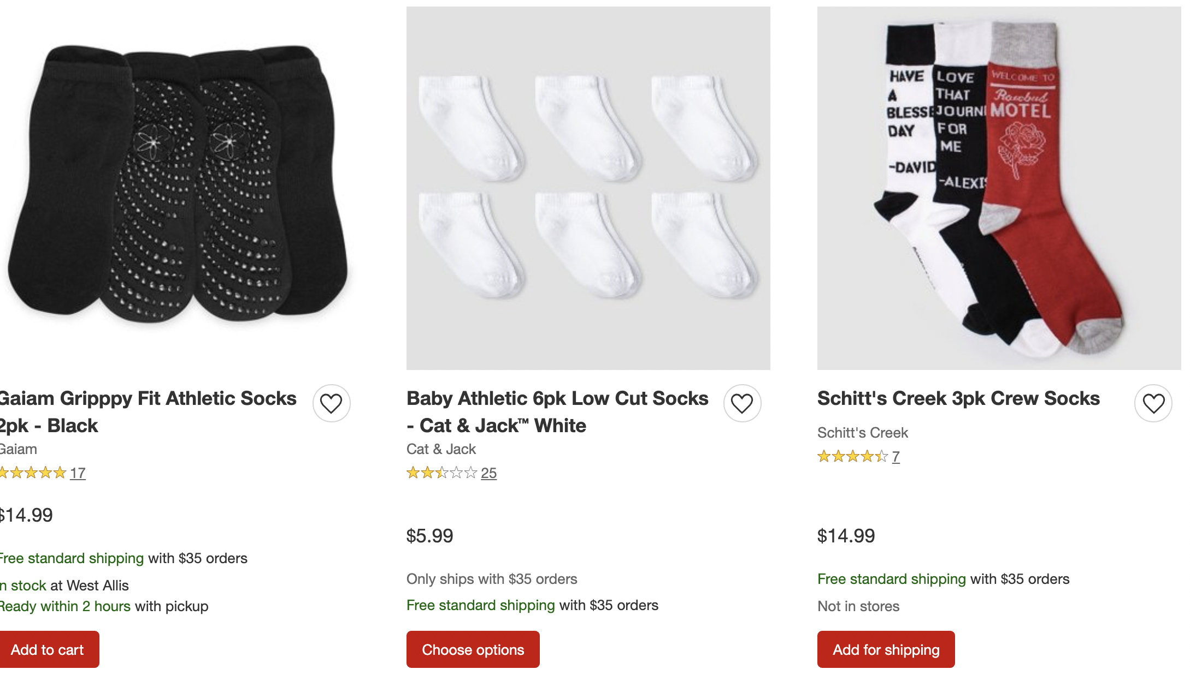
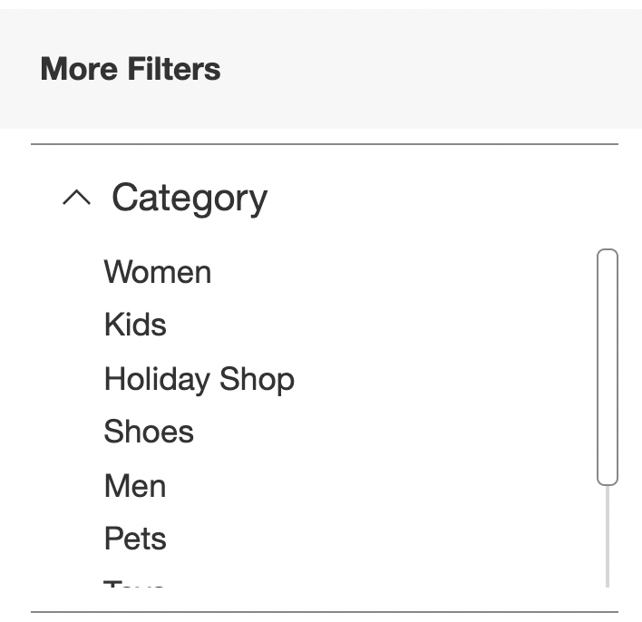
Digital Advertising
Leave, no purchase

Slide 3

Digital Advertising
Pick up in store
Checkout
Add to Cart
Ship

Slide 4
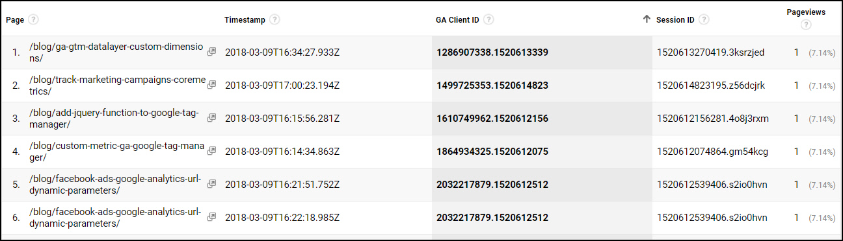
Clickstream Data
https://mixedanalytics.com/blog/quickstart-google-analytics-clickstream-data/

Slide 5
Summary
Traditional logging in Python
Structured logging
Log aggregation services
Batch log collection

Slide 6
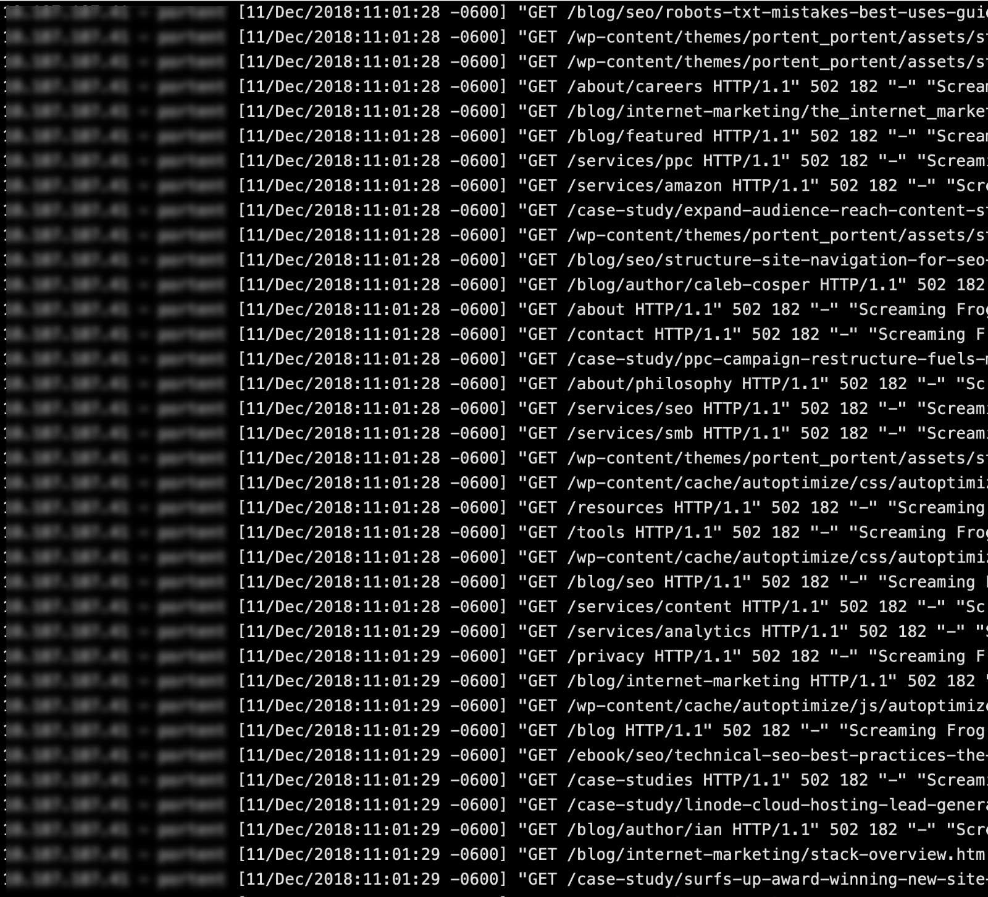
Logging
Logs are the stream of aggregated, time-ordered events collected from the output streams of all running processes and backing services.
Logs provide visibility into the behavior of a running app.
In server-based environments they are commonly written to a file on disk (a “logfile”); but this is only an output format.
Logs have no fixed beginning or end, but flow continuously as long as the app is operating.
https://12factor.net/logs

Slide 7
Python Logging
A relatively featureful logging module is distributed with the Python standard library
Logging to standard error (default) or files
Multiple logging levels
Configurable log string formats (e.g., include the name of the calling Python module or function)

Slide 8
Python Logging
Program
Console
import logging
# will print a message to the console
logging.warning('Watch out!')
WARNING:root:Watch out!

Slide 9
Logging levels
Logging libraries require that log entries are characterized by severity: info, debug, warning, error, and critical
A log entry are generated by calling the corresponding method on the logger logger.info("This is my log message")
Loggers can be configured at run time to report all log messages above a severity threshold and ignore the rest
E.g., ignore info / debug entries, display warnings and errors
Allows logging aggressively without hurting performance

Slide 10
Python Logging
import logging
logging.warning('Watch out!') # will print a message to the console
logging.info('I told you so') # will not print anything
WARNING:root:Watch out!

Slide 11
Logging Level Guidance
DEBUG: Detailed information, typically of interest only when diagnosing problems.
INFO: Confirmation that things are working as expected.
WARNING: An indication that something unexpected happened, or indicative of some problem in the near future (e.g. ‘disk space low’). The software is still working as expected.
ERROR: Due to a more serious problem, the software has not been able to perform some function.
CRITICAL: A serious error, indicating that the program itself may be unable to continue running.
https://docs.python.org/3/howto/logging.html

Slide 12
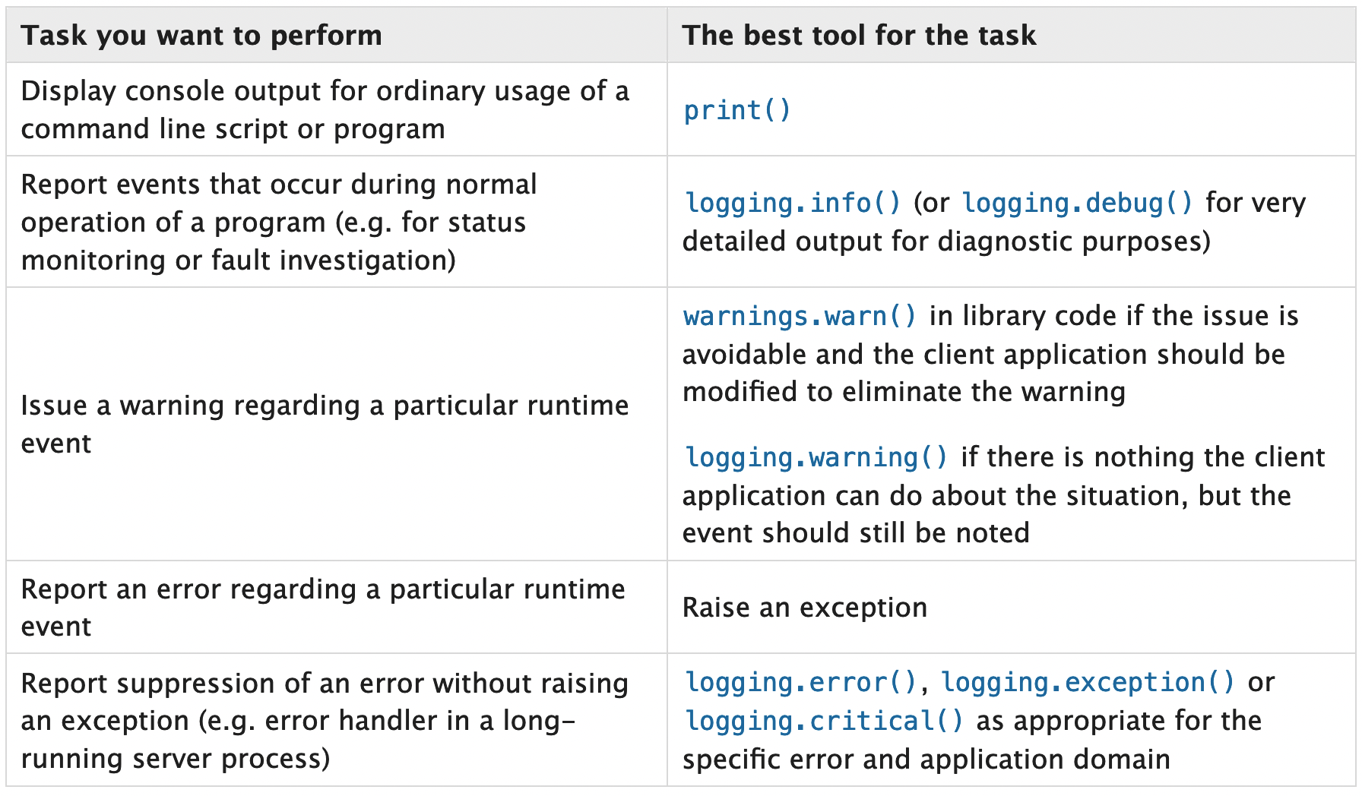
Logging Level Guidance
https://docs.python.org/3/howto/logging.html

Slide 13
Configuring the Logger
Defaults
Configurable Options
Outputs to standard error
Ignores debug / info log entries
Default format: <level>:<name>:<message>
Default logger name is "root"
Standard out, standard error, or file
Logging level
Formats with other attributes such as time, filename, module, etc.

Slide 14
Logging to a File
import logging
logging.basicConfig(filename='example.log', encoding='utf-8', level=logging.DEBUG)
logging.debug('This message should go to the log file')
logging.info('So should this')
logging.warning('And this, too')
logging.error('And non-ASCII stuff, too, like Øresund and Malmö')

Slide 15
Changing Log Message Format
import logging
logging.basicConfig(format='%(levelname)s:%(message)s', level=logging.DEBUG)
logging.debug('This message should appear on the console')
logging.info('So should this')
logging.warning('And this, too’)
DEBUG:This message should appear on the console
INFO:So should this
WARNING:And this, too (no “root”)

Slide 16
Changing Log Message Format
import logging
logging.basicConfig(format='%(asctime)s %(message)s', datefmt='%m/%d/%Y %I:%M:%S %p')
logging.warning('is when this event was logged.’)
12/12/2010 11:46:36 AM is when this event was logged.

Slide 17
Per-Module Logging
import logging
format = '%(message)s - %(module)s'
logging.basicConfig(format=format, level=logging.INFO)
logging.info('The name of the file without extension is')
The name of the file without extension is example

Slide 18
Problem: Logs are not Easily Parsed
Traditionally, the main audience for logs were humans
Programmers try to write informative log messages
Computer programs cannot reliably interpret these log messages

Slide 19
Structured Logging
Log events are modeled as records / structs / objects
{ "timestamp" : "2022-02-02 14:52:53",
"originating_server" : "127.0.0.1", "event_type" : "repeated_authentication_failure", "account" : "rnowling", "ip_address" : "127.0.0.1", "occurrences" : 2 }

Slide 20
Logging Schema
You have to define a schema
Determine a hierarchy or taxonomy of alert / metric types
Authentication failure, successful log in, search request, etc.
Determine what to log for each type of event
Which fields will be required vs optional?
Timestamp, originating server, associated user account, etc.
To evolve the schema, fields can be added over time, but it is difficult to drop fields
Have to go through a deprecation process

Slide 21
Log Event Serialization
Logs are then written out in a structured or semi-structured format
JSON:
One JSON record per line (rather than the entire file being a JSON document)
Google Protocol Buffers
Avro
May be written to a file, streamed to standard error, or sent to a network connection

Slide 22
Python structlog package
The structlog package is a logging library for writing out logs in structured format
Enforces key-value pairs through API vs relaying on programmer to generate object, serialize, and pass to logger
log.info("hello, %s!", "world", key="value!", more_than_strings=[1, 2, 3])
2022-10-07 10:41:29 [info ] hello, world! key=value! more_than_strings=[1, 2, 3]

Slide 23
structlog Configuration
import structlog
structlog.configure(
processors=[structlog.processors.TimeStamp(fmt="iso"),
structlog.processors.JSONRenderer()],
logger_factory=structlog.WriteLoggerFactory(file=log_fl))

Slide 24
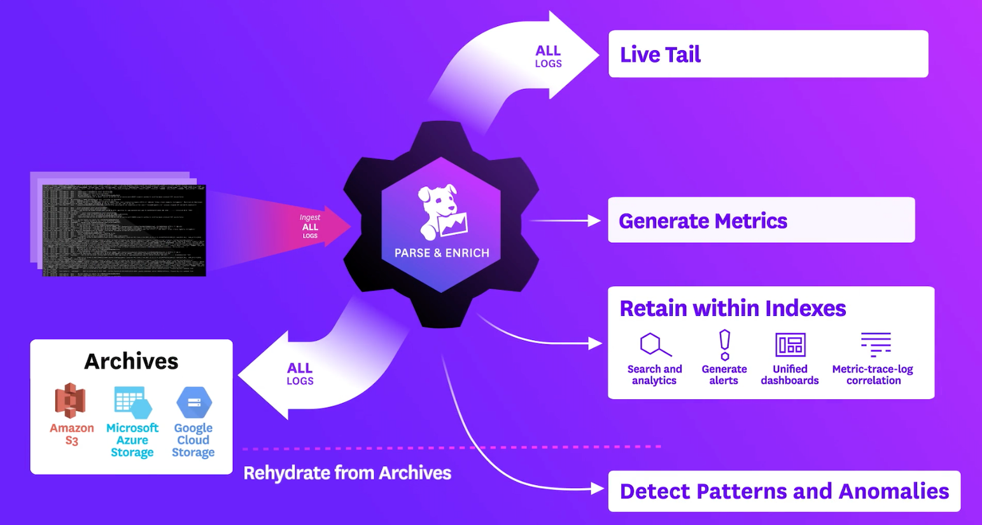
Log Collection and Aggregation Service
DevOps teams set up monitoring and alerting using services such as Datadog
Monitoring services record:
CPU, memory, disk usage
Time to respond to user requests
Whether services are unreachable for some period of time (health checks)
Number of processes / containers running

Slide 25
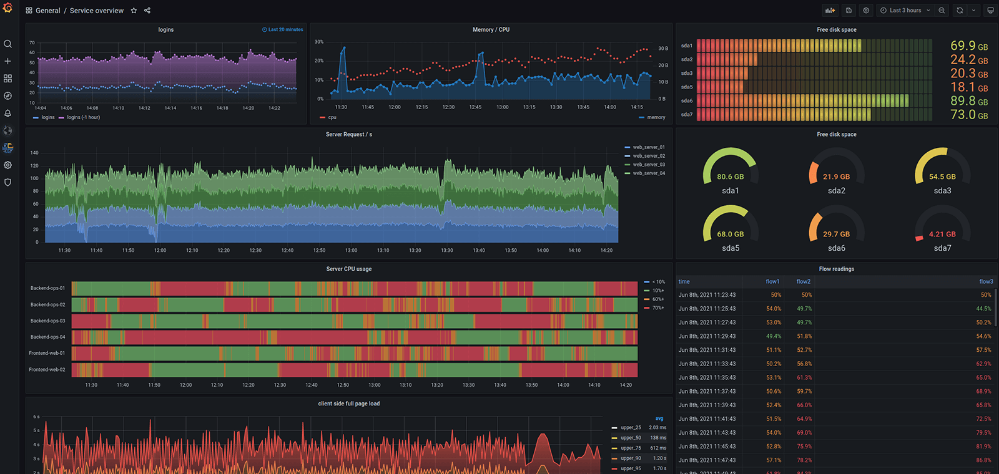
Dashboard (Grafana)

Slide 26
Two Data Types
Continuous Metrics
Discrete Events
Continuous-time signal measured at discrete intervals
CPU, memory, disk usage
Discrete events in time
Error occurred when processing a user request
Failed authorization attempt

Slide 27
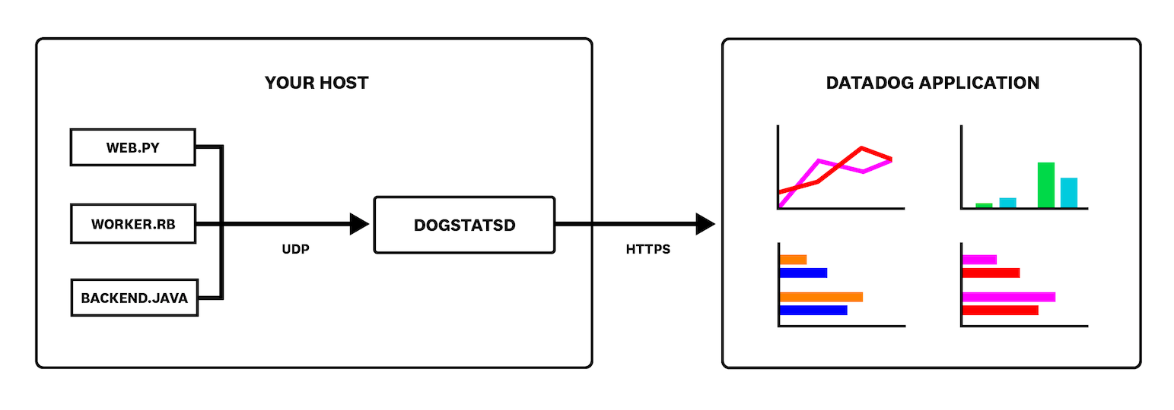
Datadog Architecture

Slide 28
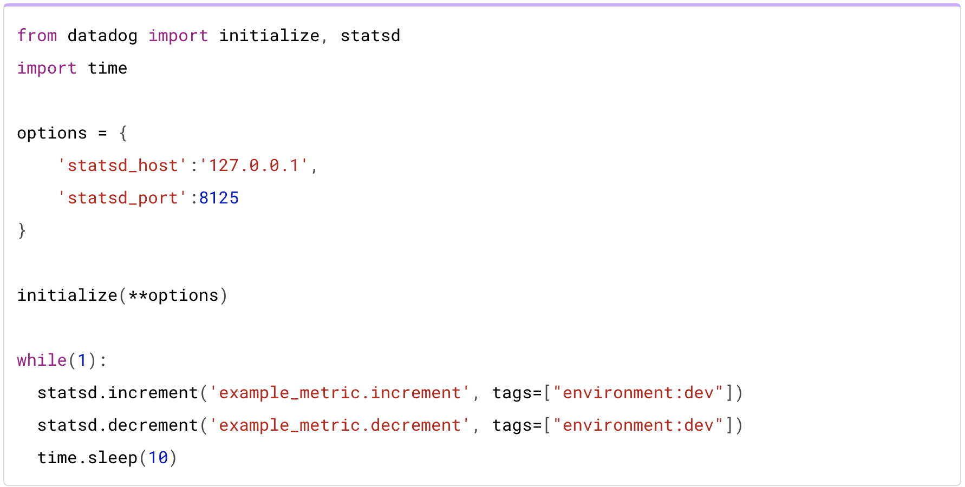
Sending Metrics

Slide 29
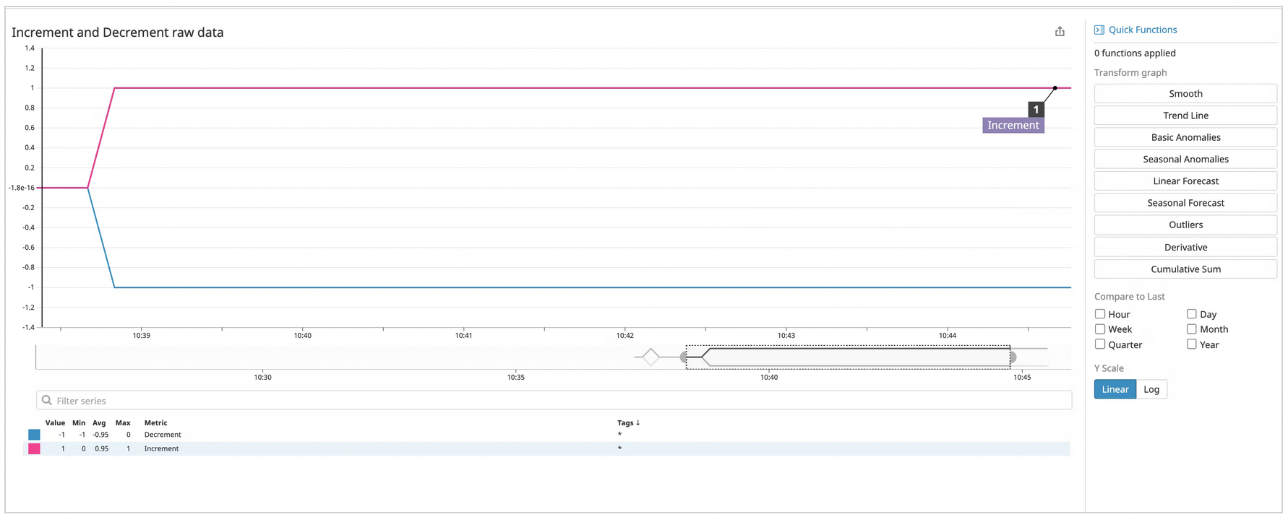
Dashboard Metrics

Slide 30
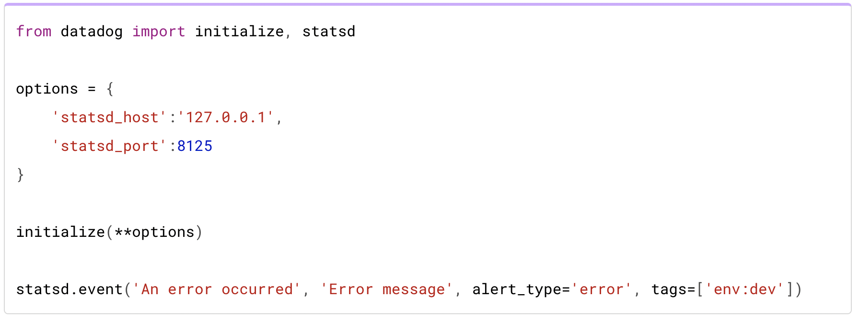
Sending Events

Slide 31
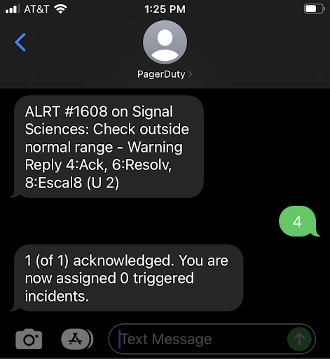
Alerts
Infrastructure teams will setup rules that trigger alerts:
CPU, memory, or disk usage hit 80%
Services are unreachable for more than 10 ms
90% percentile of response request times above some level (e.g., 200 ms)

Slide 32
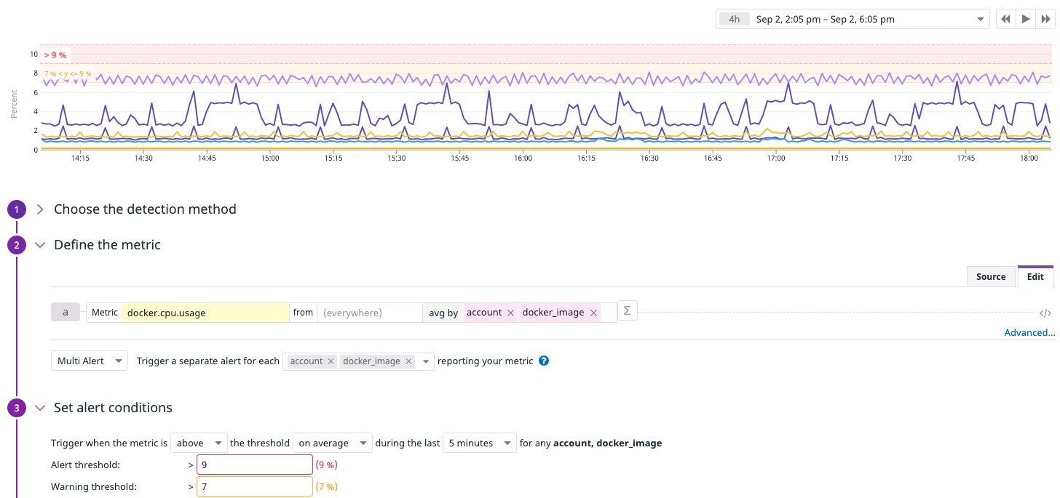
Configuring Alerting Thresholds

Slide 33
Communicating Alerts
Datadog can be configured to integrate with several delivery services for alerts:
Slack messages
Text / email
App notifications using PagerDuty

Slide 34
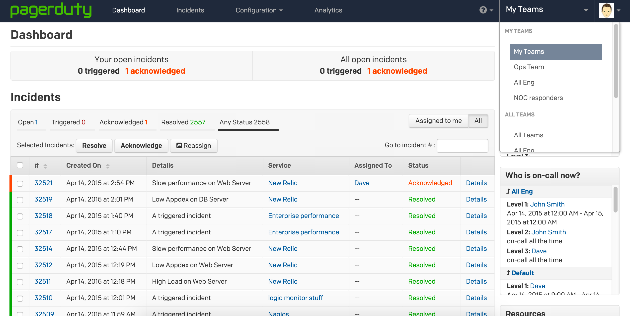
PagerDuty

Slide 35

Logging for User-Triggered Events
UI interactions
button clicks
abandoning a form before completion
Client-server interactions
page load
search
play song

Slide 36
Requirements
Don't need real-time transmission of events
Events will be processed in batches
For efficiency purposes, might as well transmit and store logs instead of individual events

Slide 37
Batch Log Collection
User-Facing Service
Log Collection Agent
Storage Service
File System
Log File

Slide 38

Fluentd
Fluentd is an example of a log collection tool
Runs on the server alongside the processes being monitored
Fluentd is configured with
log paths to monitor
the details for the receiving service

